Slide 1
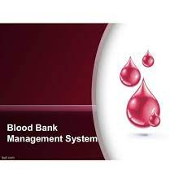
BLOOD BANK MANAGEMENT SYSTEM

Slide 2
Introduction
This project is designed for successful completion of project on blood bank management system
The basic building aim is to provide blood donation service to the city recently
This project aims at maintaining all the information pertaining to blood donors, different blood groups available in blood bank and help them manage in a better way .

Slide 3
OBJECTIVE
Automate the complete operations of BloodBank
Maintain thousand of Records
Searching Blood is very fast so they can find required details instantly
Easily Canget Donor Details and location
Aim is to provide transparency in this field, make the process of obtaining blood from a blood bank hassle free and corruption free and make the system of blood bank management effective.

Slide 4

Statement of the Problem
Scarcity of Rare Blood Group
Unavailability of Blood During Emergency
Less Awareness among people about Blood Donation
Deaths due to lack of blood during operations

Slide 5
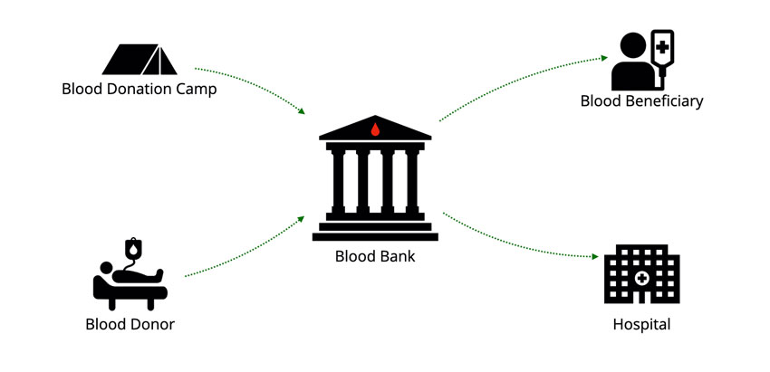
Modules
Search Donor
Become A Donor
Blood collection
Blood issued
Donor Details

Slide 6
SOFTWARE REQUIREMENTS

Slide 7
Advantages
Paperless Work
Fast Process
Real time information form collection of donor
The citizen can easily access the donor details
Send queries like Availability of blood, donor info, how to become donor etc.

Slide 8
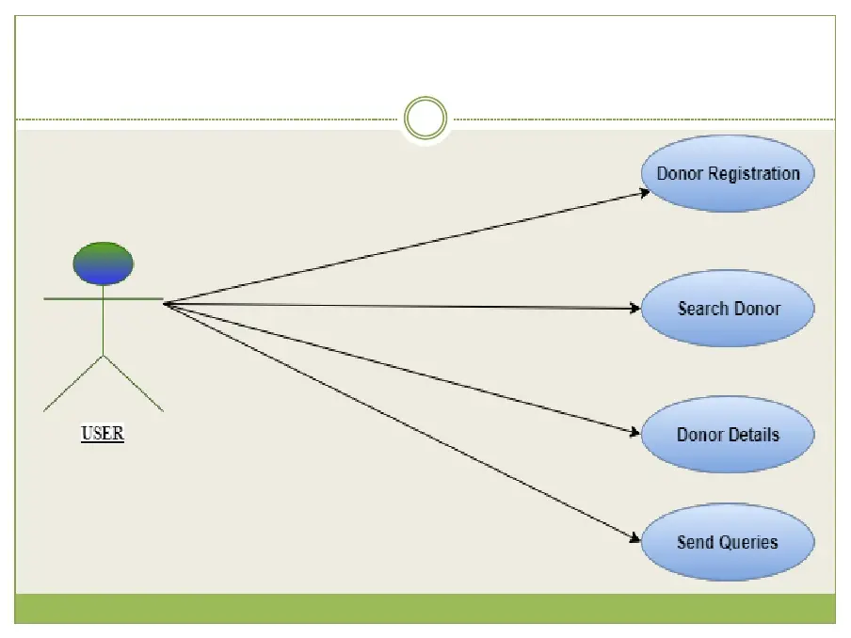
Activity Diagram

Slide 9
Importance of Blood Bank
Blood banks are laboratory centers that are responsible for collection, processing, typing, safety and storage of Blood for research and medical purpose
Most blood collected for medical use is transfused into patients who need blood

Slide 10
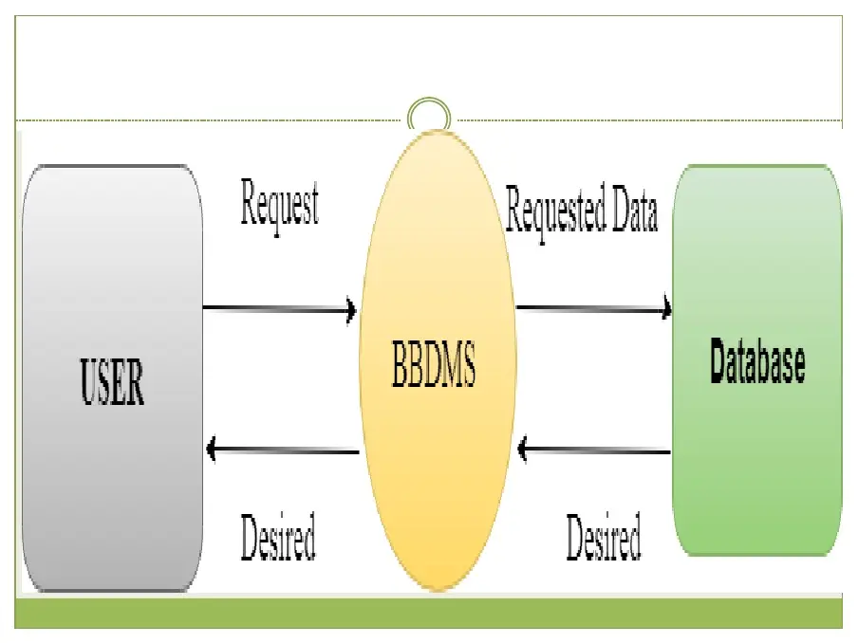
Data Flow Diagram

